Slide 1
Medical Terminology:
Learning Through Practice, 1e
Paula Bostwick
Chapter 14
Digestive System and Body Metabolism
©McGraw-Hill Education. All rights reserved. Authorized only for instructor use in the classroom. No reproduction or further distribution permitted without the prior written consent of McGraw-Hill Education.

Slide 2
Learning Outcomes
14.1 Describe the basic function and structure of the digestive system and body metabolism.
14.2 Recognize the major word parts used in building words that relate to the digestive system.
14.3 Recall the common diagnostic tests, laboratory tests, and clinical procedures used in treating disorders of the digestive system.
14.4 Define the major pathological conditions of the digestive system.
14.5 Define surgical terms related to the digestive system.
14.6 Recognize common pharmacological agents used in treating disorders of the digestive system.
14.7 Identify common abbreviations associated with the digestive system.

Slide 3
14.1 Structure and Function of the Digestive System
Gastroenterology
Breakdown, metabolize, and supply nutrients to the body
Peristalsis = Movement
Alimentary system
Common/recognizable major organs
Accessory organs vital for metabolism

Slide 4
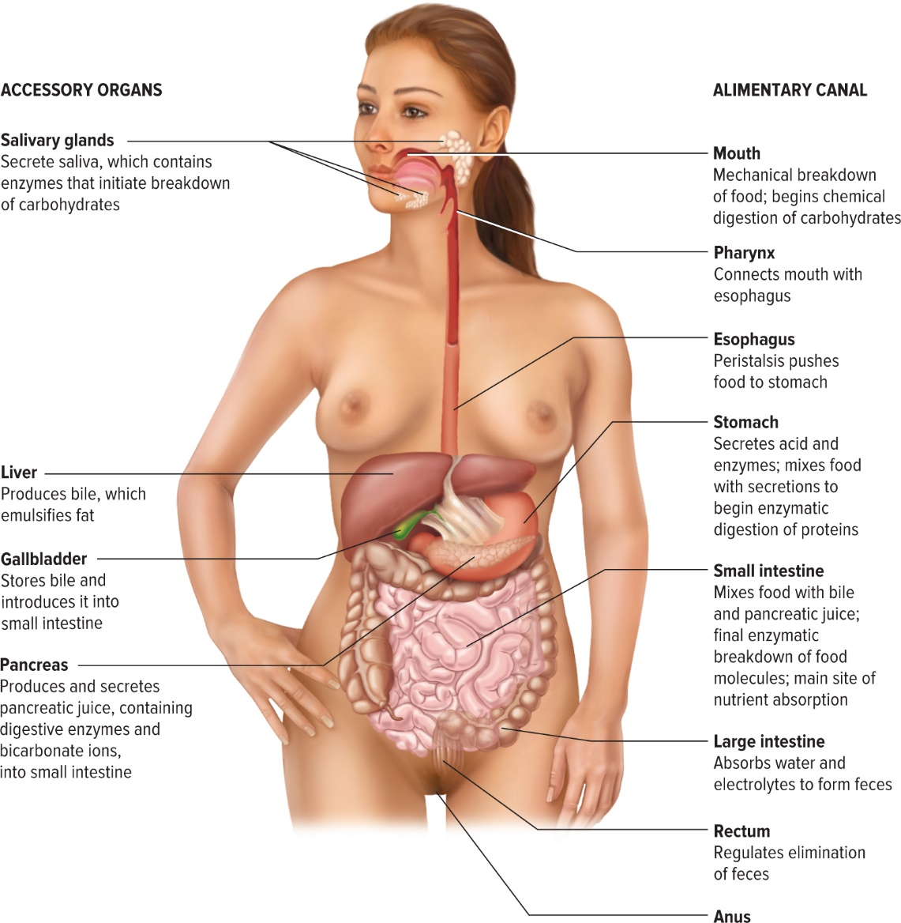
Organs
Access the text alternative for these images

Slide 5
Building Vocabulary 1
stomat(o) | mouth
dent(o)/ odont(o) | teeth
gloss(o)/lingu(o) | tongue
cheil(o) | lips
gingiv(o) | gums

Slide 6
Building Vocabulary 2
esophag(o) | esophagus
pharyng(o) | pharynx
gastr(o) | stomach
enter(o) | intestine
duoden(o) | duodenum

Slide 7
Building Vocabulary 3
jejun(o) | jejunum
ile(o) | ileum
colon(o) | colon
sigmoid(o) | sigmoid colon
rect(o) | rectum
proct(o) | anus and rectum

Slide 8
Building Vocabulary 4
Accessory Organs
hepat(o) | liver
cholecyst(o) | gallbladder
chole | gall
cyst(o) | bladder
pancreat(o) | pancreas
saliv(o) | salivary glands

Slide 9
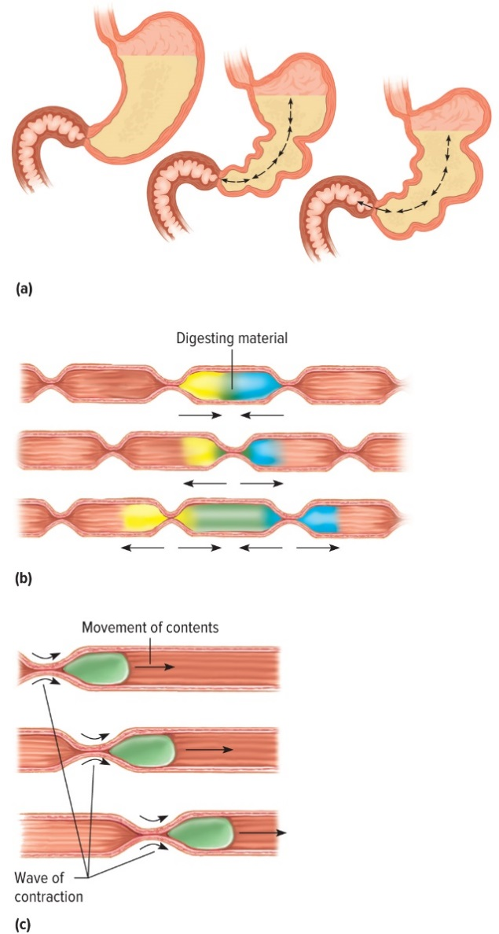
Movement of Food

Slide 10
Digestive / Metabolism Parts
Begins in the mouth = stomat(o)
Tongue, teeth, and lips (break down food)
Salivary glands (saliva)
Mastication = chewing
Next pharynx = pharyng(o)
Then esophagus = esophag(o)

Slide 11
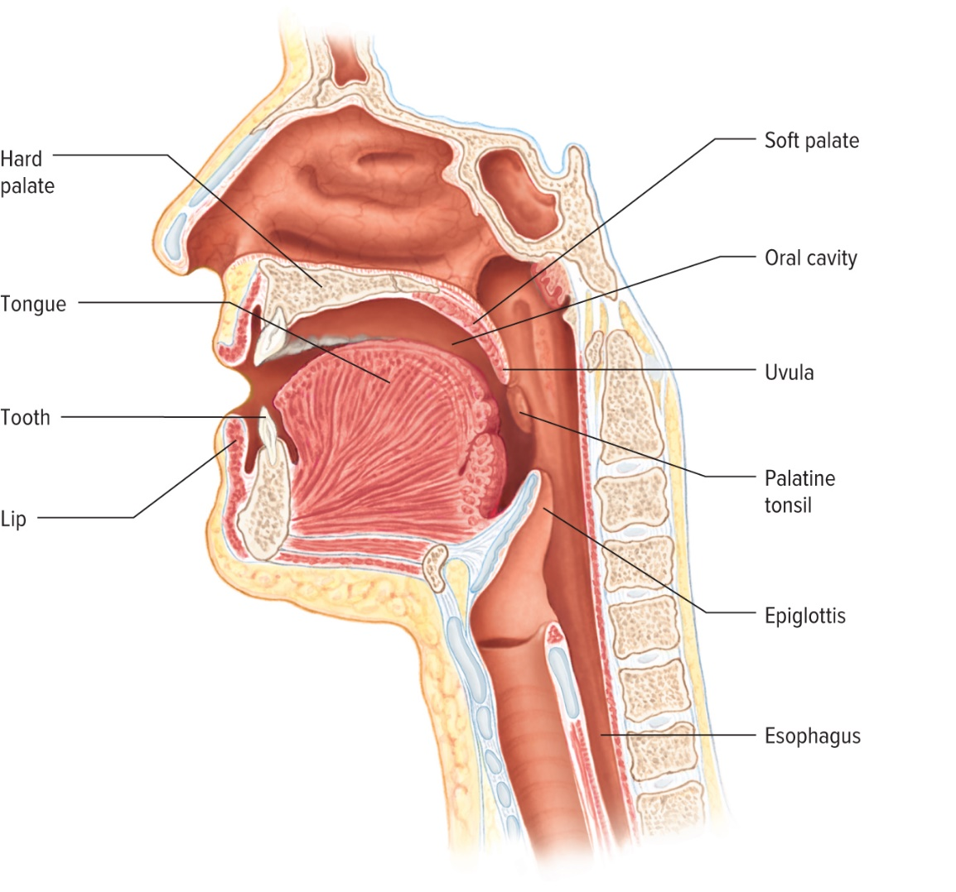
Mouth, Pharynx, Esophagus
Access the text alternative for these images

Slide 12
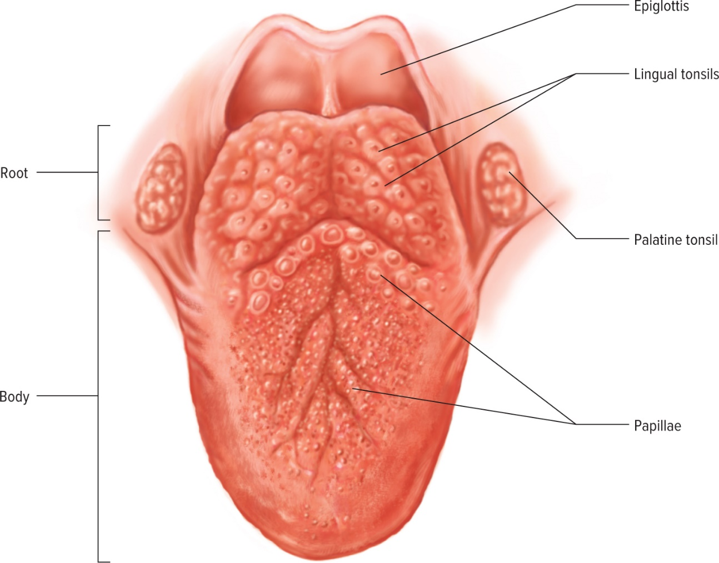
Tongue, Epiglottis, Tonsils

Slide 13
The Stomach
Stomach = gastr(o) pouch like organ
Holds over 1 liter of food
Break down food, initiate protein digestion, mix with enzymes
Gastropathy = stomach condition

Slide 14
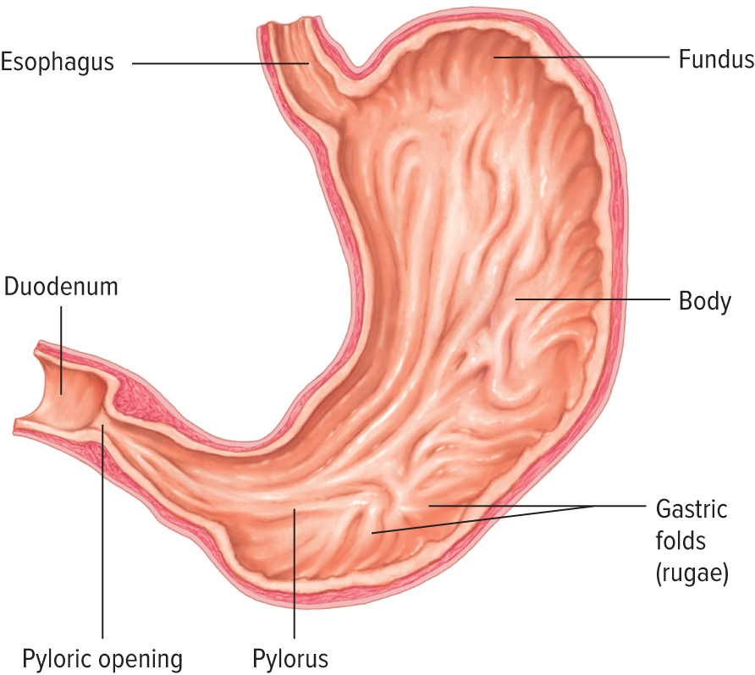
Parts of the Stomach

Slide 15
“Heartburn”
Cardiac region = cardiac sphincter
Allows food to enter
Prevents regurgitation
Sphincter failure = allows gastric juices to reflux into the esophagus
No protective lining = “burning feeling”

Slide 16
Stomach “Juices”
Extremely acidic = digestion
Protective lining in stomach and intestines
Rugae = folds in the lining
Stomach fills = folds disappear

Slide 17
Small Intestine 1
Intestines = enter(o)
Longest tube-like organ
Extending from pylorus of the stomach to large intestines
Nutrients absorbed
Duodenum, jejunum, and ileum

Slide 18
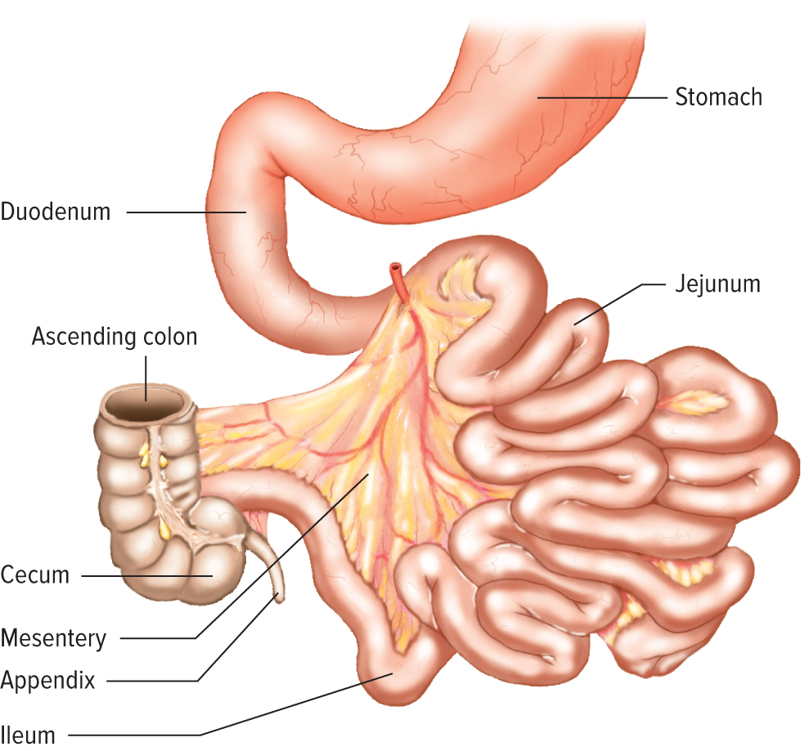
Small Intestine 2

Slide 19
Large Intestine
Large intestine = colon(o)
Solidify waste = reabsorbs water, salts, electrolytes
Ascending, transverse, and descending sections
End section sigmoid = sigmoid(o)

Slide 20
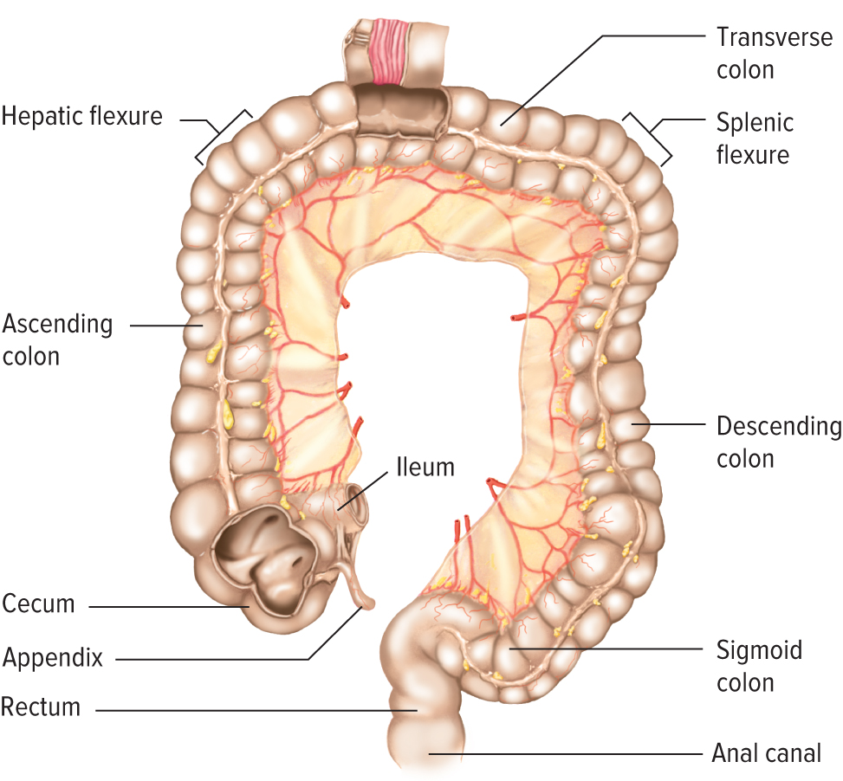
Large Intestine (Colon)
Access the text alternative for these images

Slide 21
Digestive Accessory Organs
Liver = hepat(o) largest organ upper-right cavity, many functions, bile secretion
Gallbladder = chole = gall, cyst(o) = bladder, pear-shaped sac, stores bile until needed

Slide 22
Pancreas
pancreas = pancreat(o)
part of the endocrine system
closely attached to small intestines
secretes juices that metabolize fats, carbohydrates, and proteins

Slide 23
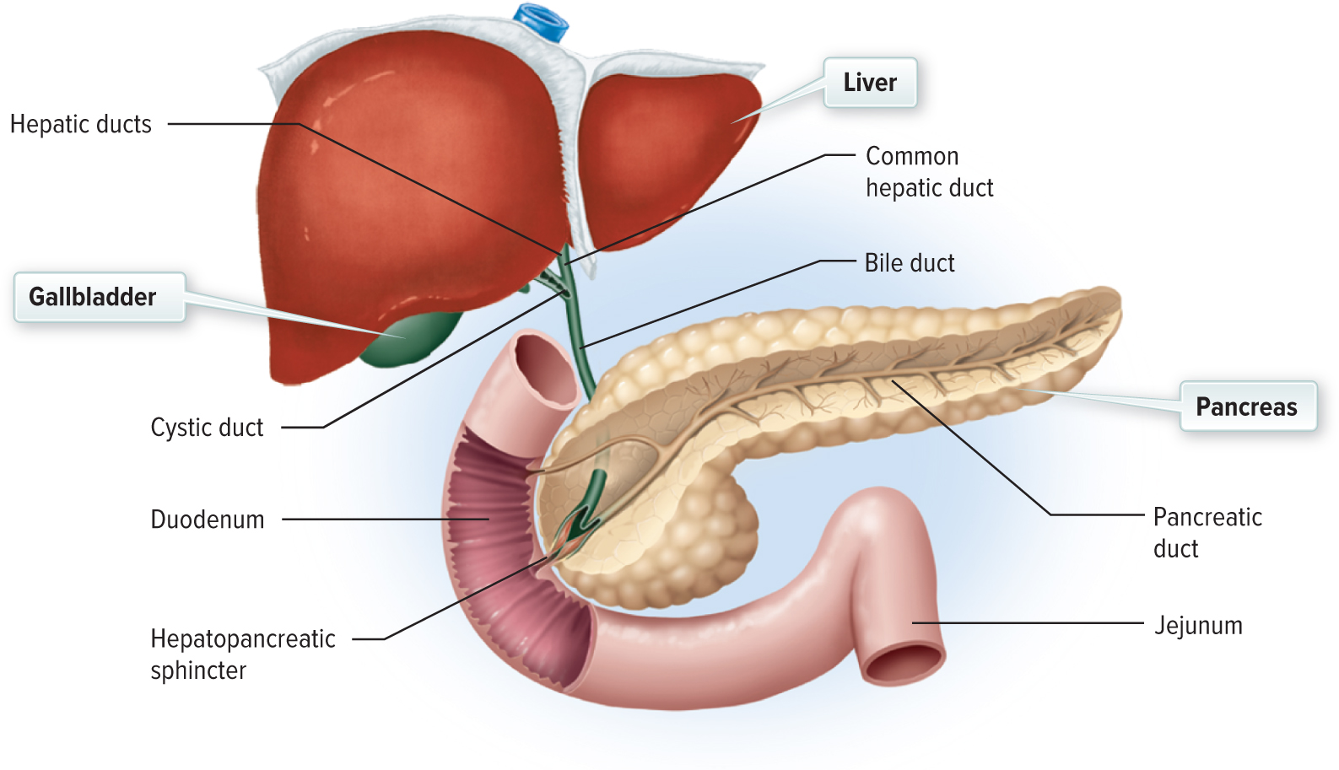
Liver, Pancreas, and Gallbladder
Access the text alternative for these images

Slide 24
LO 14.3 Diagnostic, Procedural, and Laboratory Terms
Scopes to view the alimentary canal—least risky—cost-effective
Types of scopes:
  Enteroscopy
  Proctoscopy or sigmoidoscopy
  Colonoscopy
  Endoscopy
Proct(o) = rectum/anus + -scopy = viewing using a scope

Slide 25
LO 14.4 Pathological Terms
Eating disorders
More females diagnosed
Bulimia = to eat and purge
Anorexia nervosa = to not eat as a disorder

Slide 26
Symptoms of Bulimia
Swollen salivary glands
Irritation of the esophagus
Stomach ulcers

Slide 27
Symptoms of Anorexia Nervosa
Hair loss
Fainting/fatigue
Loss of heart tissue/ decreased heart rate
Lanugo
Little subcutaneous fat
Loss of menstrual periods
Low bone mass
Muscle tears/stress fractures
Low body temperature
Bruising
Low metabolic rate/cold intolerance

Slide 28
Disorders of the
Mouth, Pharynx, Esophagus
Secondary to other problems
Mouth sores = allergic reactions, viruses, bacterial infections from poor dental care
pharyng(o) pharynx, cheil(o) lips,
stomat(o) mouth, esophag(o) esophagus

Slide 29
Stomach Disorders
Gastralgia / gastrodynia = stomachache
Very common problem
Dyspepsia = indigestion
Stress, overeating, peptic ulcers

Slide 30
Liver, Pancreas, Gallbladder
Disorders
Gallstones, or cholelithiasis
Abnormal production of calcium deposits in the gallbladder
Asymptomatic / very painful
Block the normal flow of bile choledocholithiasis.

Slide 31
Hepatitis
Hepat(o) liver + itis = inflammation
Types of hepatitis (4)
Acute / chronic
Mode of transmission
Risk factors

Slide 32
Intestinal Disorders
Colitis = colon inflammation
Types of colitis
Ulcerative colitis
Crohn disease
Biopsy may be needed

Slide 33
The Rectum and Anus
Hemorrhoids = varicose veins
Hereditary, repeated strain, and/or sitting for long periods of inactivity
Asymptomatic or discomfort from swelling

Slide 34
Hernias
Any loop or twist of bowel or any organ not positioned correctly in the abdomen
Types of hernias
  Hiatal
  Inguinal
  Strangulated
  Femoral
  Umbilical

Slide 35
LO 14.5 Surgical Terms 1
Gastroenterologists and surgeons work together because most GI disorders require surgery.
Some physicians do both.
Some surgeons specialize in gastric bypass and colorectal surgeries.

Slide 36
Surgical Terms 2
abdominocentesis
paracentesis
cholelithotomy
choledocholithotomy
cholelithotripsy
glossorrhaphy
esophagoplasty
proctoplasty
glossectomy
polypectomy
appendectomy
cholecystectomy
diverticulectomy
gastrectomy
gastric resection

Slide 37
Surgical Terms 3
gastric bypass
colectomy
pancreatectomy
hemorrhoidectomy
hepatic lobectomy
liver biopsy
anal fistulectomy
Billroth I
Billroth II
anastomosis
ileostomy
colostomy

Slide 38
LO 14.6 Pharmacological Terms
antacid
antidiarrheal
antiemetic
antispasmodic
cathartic
laxative
corticosteroids

Slide 39
LO 14.7 Abbreviations
BM (bowel movement)
BMI (body mass index)
EGD (esophagogastroduodenoscopy)
HAV (Hepatitis A)
IBS (irritable bowel syndrome)
LFT (liver function test)
PUD (peptic ulcer disease)
TPN (total parental nutrition)
UGI (upper gastrointestinal)

Slide 40
Chapter Summary 1
14.1 The digestive system is comprised of major organs and accessory organs that function to work together to process and metabolize food products and provide nutrients to the body.
14.2 Word building requires knowledge of word parts and their corresponding meanings to form medical terms within the digestive system.
14.3 Diagnostic, procedural, and laboratory findings assist the health care provider in diagnosing medical conditions. Often used in combination, these tests lead to a final diagnosis and assist in treatment planning.

Slide 41
Chapter Summary 2
14.4 Knowledge and understanding of diseases and conditions of the digestive system, including acute and chronic diseases, structure, repair and treatment to promote function, and cancer increase critical thinking related to pathological medical terms.
14.5 Surgical procedures within the digestive system revolve closely around repair of damaged or nonfunctioning structures and treatment of cancer within the system.

Slide 42
Chapter Summary 3
14.6 Primary and common pharmacological agents used in the digestive system are symptomatic relief agents, peristalsis-promoting or -inhibiting agents, and corticosteroids.
14.7 Abbreviations are used to describe diseases, conditions, procedures, and treatments associated with the digestive system.

Slide 43
Accessibility Content: Text Alternatives for Images

Slide 44
Organs Text Alternative
The accessory organs include the salivary glands, liver, gallbladder, and pancreas. The alimentary canal includes the mouth, pharynx, esophagus, stomach, small intestine, large intestine, rectum, and anus.
Return to slide containing original image

Slide 45
Mouth, Pharynx, Esophagus Text Alternative
The mouth, nasal cavity, and pharynx contain the hard palate, tongue, tooth, lip, soft palate, oral cavity, uvula, palatine tonsil, epiglottis, and esophagus.
Return to slide containing original image

Slide 46
Large Intestine (Colon) Text Alternative
There are three main sections to the colon: the ascending, transverse, and descending colon. The hepatic flexure is the sharp bend between the ascending colon and the transverse colon. The splenic flexure is the sharp bend between the transverse colon and the descending colon.
Return to slide containing original image

Slide 47
Liver, Pancreas, and Gallbladder Text Alternative
The liver is in the upper right abdominal cavity just below the diaphragm. The gallbladder is a small pear-shaped sac that lies protected against the inside surface of the liver. The pancreas is closely attached to the small intestine.
Return to slide containing original image

